Slide 1
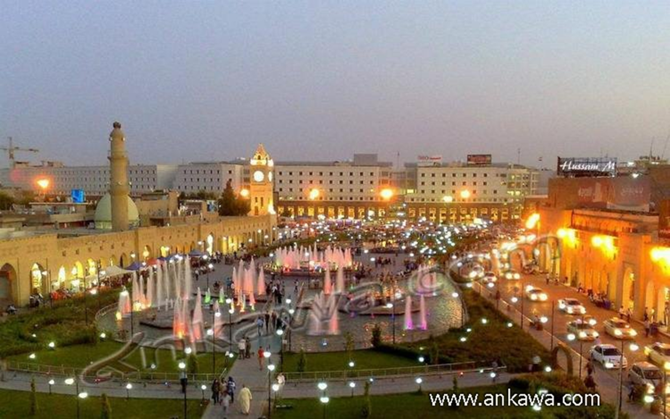
Effect of urban design on the tourism facilities
Dr. siba I. Taha
P.H.D. in Architectural & urban design

Slide 2
INTRODUCTION
Tourism is an important economical activity for host countries, and good communication
mean between different cultures. In the latest years, many countries had paid great deal of attention for tourism as a strong economical resource, this caused competition between them in order to attract visitors.
Urban Tourism, or “tourism of cities”, is one of the growing orientations; many cities are trying to develop tempting environments, taking advantage of available heritage, religious, cultural, entertainment, and other attractions.
This paper research is attempting to demonstrate the possibility of developing a physical urban environment in general to increasing and promoting the tourism facilities in the center of city .
The paper take Erbil city center as example to clarify the relation between the elements of urban environment and the tourism facilities also This importance of city that is drained from its cultural heritage value represented by
the citadel that is the core of the area

Slide 3
tourism
can be defined as: “the activities of people
travelling for leisure purpose to another place, not for intentions of permanent inhabiting.”
Leisure process
can be defined as: the activity or activities that a person carries out at the level of Personal or social levels, at his/her own free time, to get some kind of
satisfaction or physical or psychological relief. These activities (or activity) might be
physical, mental, or emotional .

Slide 4
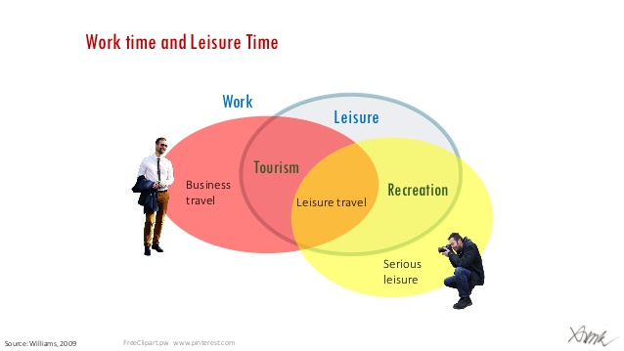

Slide 5
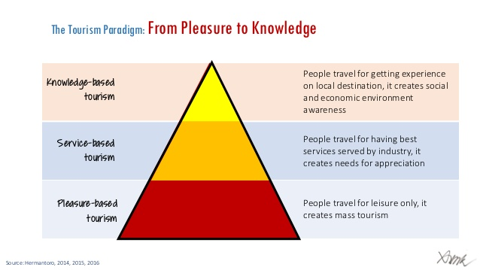

Slide 6
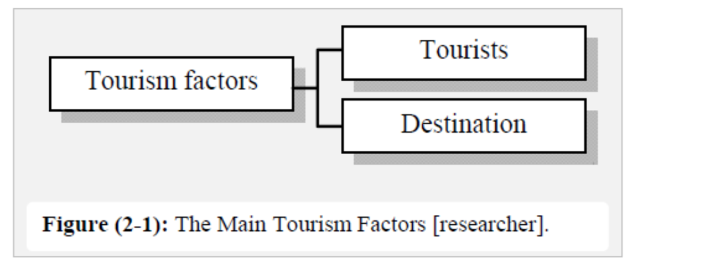
there are two main factors of tourism that determines its
quality, development, and activity; these factors are (figure 2-1):
1. People (tourists): Those who have “free time” and willing to spending it
travelling for leisure for another place.
2. Place (destination): places that are visited ; and have a certain motivation that
includes leisure, to be visited.

Slide 7
three types of tourist cities:
" Resort cities are places created expressly for consumption by visitors;
" Tourist-historic cities are places attractive to visitors due to their historic
and cultural identity. These cities have been sites for tourism for a long
time, but in many cases a program of conscious promotion and
reconstruction of heritage has transformed them into tourist sites;
" Converted cities have built an infrastructure for the purpose of attracting
visitors. Typically, sites of production, such as manufacturing and port
facilities, are either adapted to new uses or replaced, and a standard menu
of new facilities is constructed specifically for tourists.

Slide 8
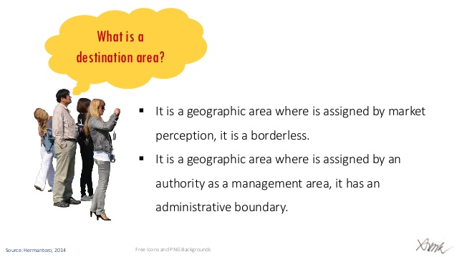

Slide 9
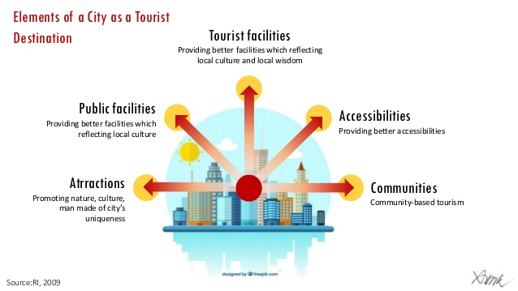

Slide 10
the demand side is related to the tourists’ interest and will and
ability to visit the destination, and ability can refer to their financial or physical
abilities, their free time, and other circumstances related to them.

Slide 12
Supply:
The supply side
includes all the objects and services that are provided to meet demand. The supply side
includes all those programs and land uses that are designed and managed to provide for
receiving visitors. The supply side of tourism embodies more than just business;
inherent features of destinations are also “supplied” to tourists]. It
is the sum of resources, physical assets and organizations employed in tourism to serve to the tourists.
This could be categorized into two characters of a tourist destination:
1. Attractions;
2. Facilities and services

Slide 13
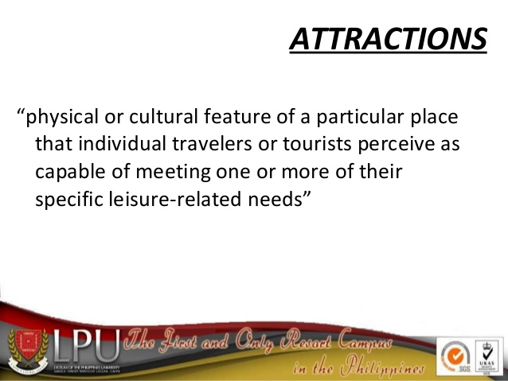

Slide 14
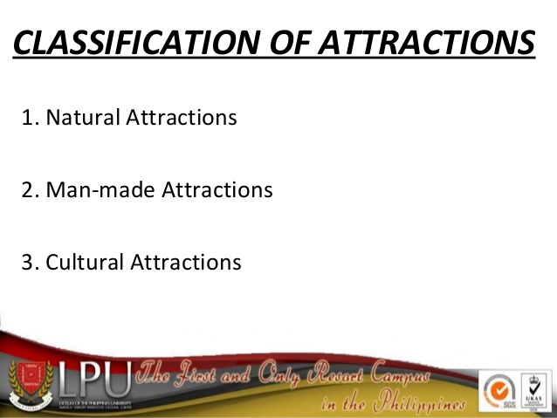

Slide 15
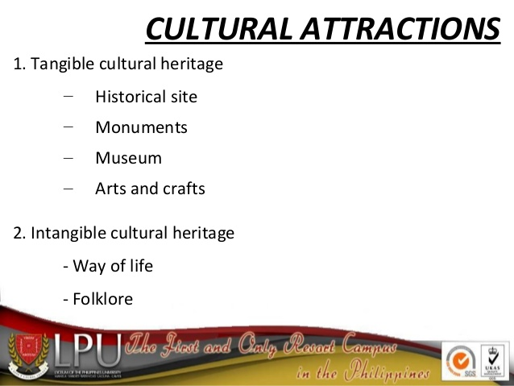

Slide 16
2. Facilities and Services
Services and facilities are one of the basics of growing and flourishing solid tourism.
The reason of this is that tourists usually visit the tourist destination for physical and
mental relaxation and amusement, any deficiency of services will affect this purpose,
and may take away their leisure of being in this destination, and in turn this will affect
the tourist activity.
All the businesses providing basic and supportive services for travelers also serve local
resident markets. Restaurants, shops, entertainment, and local transportation businesses
receive much of their trade and revenues from residents as well as travelers. This
fundamental influence location. Services depend on attractions, which mean that service
business function is intimately related to attractions. Therefore, the business sector
should cooperate on plans for increased developments of attractions [Facilities and Services can be classified to:
Accommodations:
Accommodation is a term used to encompass the provision of
bedroom facilities on a commercial basis within the hospitality/tourism industry.

Slide 17
2. Catering: this includes establishments to serve food and drinks for tourists, such as
restaurants and cafeterias, also cafes that provide this kind of services. residents, in addition to serving food and drinks.
3. Shopping: this includes every form of buildings and districts that provide exigencies
for tourists, in addition to provide tourist souvenirs and other types of goods, such as
shopping markets, centers, and malls.
4. Transportation:
Transportation (carriage) in its broadest sense is one of the pillars of tourism and
highlighted components of the system tourist.
5. Infrastructures:
Infrastructure includes all forms of construction required by an inhabited area in
communication with the outside world, which support and make economic development
.

Slide 19
the urban environment :
is a set of basic elements (monuments,
streets and plazas) that are related and have certain physical and functional
characters that determines the general character of an urban environment.
Certainly those categories might overlap (for example, a historic city may include a
religious place, or a religious city may have certain natural qualities that attract
tourist as well), but generally, a main property of an urban area is more likely to
be the cause of being classified as a tourist region inside a city. The major
attraction feature will determine the type of urban tourism in the city.

Slide 20
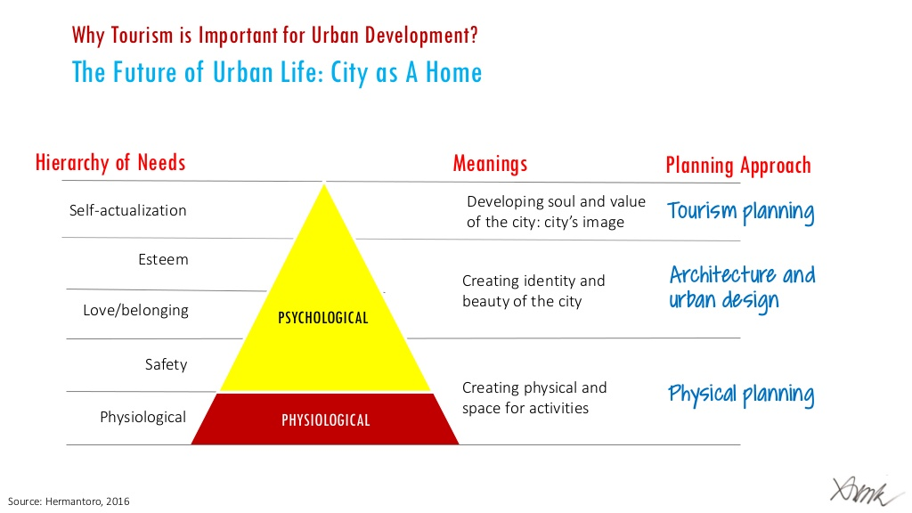

Slide 21
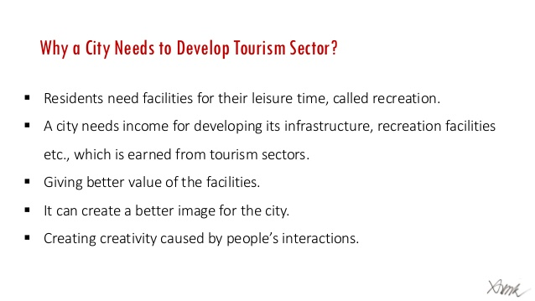

Slide 22
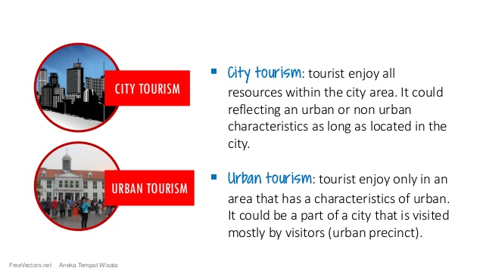

Slide 25
Designing tourist districts
Tourist districts include tourist attractions and areas that are prepared for receiving
tourists and meet their needs and satisfaction. In addition to new parts, the designs for
these places include the processes of rehabilitation, maintenance and providing services
and infrastructure in order to be fit to receive visitors.
Tourism could help :
1- change in the image of a city and raise its profile and this in turn
would assist it to attract various types of investment.
2- Tourism would also help physical regeneration as new resources such as visitor attractions and convention centers were
built on derelict or under-used land and ancillary activities brought back in to use old
Buildings.

Slide 29
Erbil City Centre
Erbil city center was selected because of the following characteristics:
1. Cultural Heritage value.
Historically, Erbil is believed to be one of the oldest continuously inhabited cities in the World.
include the 8,000 year old Citadel of Irbil, which claims to be one of the longest continuously inhabited walled cities,
2. Location importance:
Erbil city center is located in the center of centralized city, that makes it the beating heart of the city and the center for commercial activities.
3. Architectural and planning value:
Erbil city center has architectural and planning values represented by the traditional houses and markets in and outside the citadel, such as the traditional houses in Arab and
Khankah mahallas, and the quaissarya type of the Great Bazar.

Slide 31
Analysis of city center of erbil :
1. Land Uses:
, land uses were classified into three main uses:
• Residential: this is represented by the citadel and most of Arab district, and several residences in Mustawfi and Khanaka districts. On 2006, the citadel was cleared out from residents for conservation issues.
• Commercial; this is mainly concentrated in Bazar and Khanaka districts.
• Institutional (Governmental): this is concentrated on Mustawfi district. Mixed uses are limited and generally constrained in Arab district, due to its origin as a residential district, that parts of were transformed into commercial, also some of commercial stores of this district, were transformed into commercial/lodging
uses.

Slide 33
2-. Buildings Conditions:
Most of Erbil city center have poor building conditions in general, specially the old districts, such as the Citadel and the residents in Arab district, was caused as a result of the progress of time and frequent neglect and lack of Maintenance.
3. Infrastructures :
The city center suffers from severe lack of services and infrastructures, due to many reasons such as neglecting, overloading by users, and lack of maintenance, resulting in damage to many of the services previously created and the lack of interest in the newly created services.
4. Landscape and Open Space :
Open spaces are not largely prevalent in the City Centre area, although there are plans for a higher percentage of open spaces throughout the larger city development.
The current parks are large scale parks, which do not meet the needs of local residential communities or commercial areas.

Slide 35
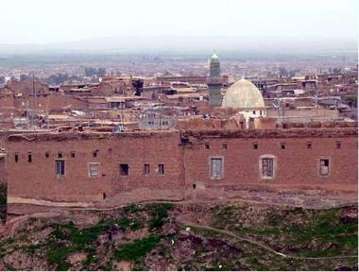

Slide 37
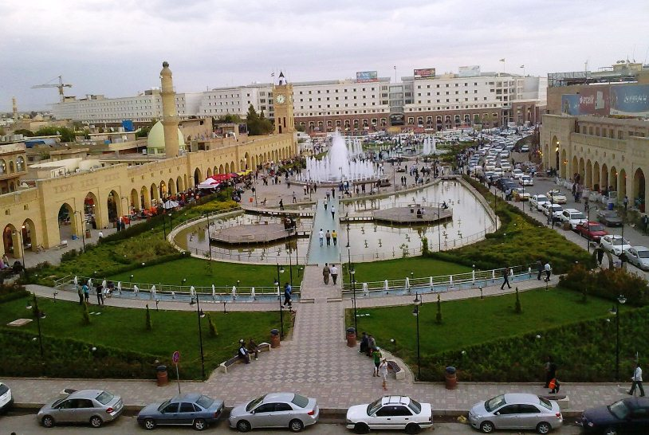

Slide 38
5. Traffic and Circulation:
Circulation roads include two main types: pedestrian and vehicles. They are divided into
three forms:
-Ring roads around the citadel,
- Radial roads: perpendicular on ring roads, radial from the citadel;
- Organic streets in the citadel and the old zones in Arab district.
The main problem of circulation can be summarized by the following:
• Lack of clarity for junctions between pedestrian and vehicle circulation.
• The cut of pedestrian circulation between the citadel and the surrounding
traditional districts, which isolates the citadel and weakening of its importance
as part of the whole center.
• Intersection of pedestrian circulation by vehicle circulation in overloaded zones
and the lack of good and sufficient parking areas in the district in general.
• The main function of the area is commercial-cultural, which requires the
dominance of pedestrian circulation, but the intersection between the two types
of circulation caused overloading.
• The two types of circulation suffer from the lack of gradient, which caused a
negative fusion between them.

Slide 40
6-.The Attractions points :
The main attractions in Erbil city center are:
1. Cultural-Heritage Attraction:
Cultural-heritage attraction in Erbil city center is represented by the distinct
architectural heritage in Erbil citadel and parts of Arab and Khanakah districts, except
2-. Shopping Attraction:
The district is known locally as “Suq Al Qalaa” (the market of the citadel) which is the
main and major shopping district in Erbil. It consists of domestic goods market, general
clothing, household supplies, computers and electrical devices (hardware) and other
goods.

Slide 41
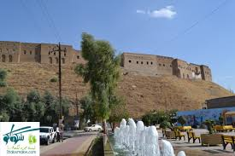

Slide 42
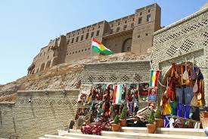

Slide 43
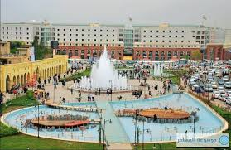

Slide 45
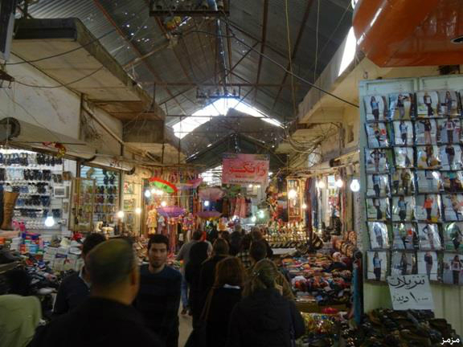

Slide 46
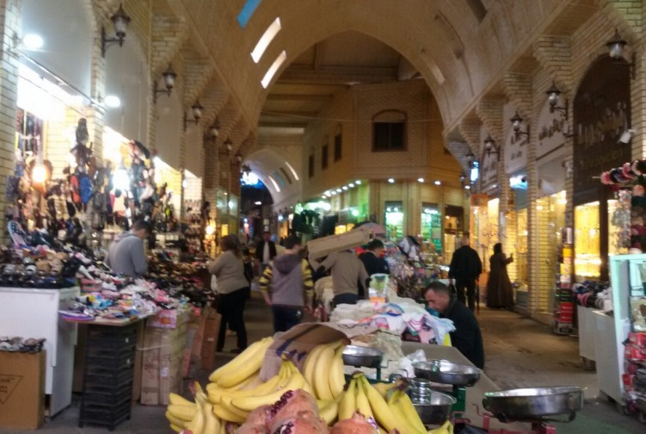

Slide 47
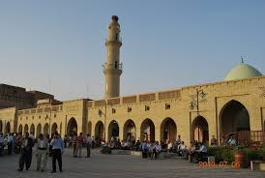

Slide 48
This market has tourist values for the following reasons:
- Its cultural heritage value as a traditional market with its organic vernacular urban fabric, and narrow alleyways and small shops.
- Its central location and the diversity and comprehensive of its goods.
- Its vitality during daytime and closeness to the most vital districts in the city (such as
Tairawa and Iskan.
Although as a function, the citadel market almost covers most of the necessary needs, and even the accessories, its structure suffers from neglecting the major problems of the
market can be summarized by the flowing:
1. Neglecting for maintenance especially for the old buildings that carries an important (folklore) character, which could be used as an important tourist attraction, this led for decline in the physical conditions in many buildings
and they were demolished totally or partially.

Slide 49
2. Bad condition for finishes and paving, in addition to the esthetic features, especially in old districts.
3. Bad lighting features.
4. The market lacks of vitality at nighttime, which makes it uncomfortable, this could affect the tourists most of all hence they are strangers from the district.
5. Also it was regarded as an important project, Nishtiman mall has a bad influence on the district for many reasons:
• It is a huge bulk that competes the monument of citadel
• Its architectural style and building materials are strange to the
district’s general character.
6. The isolation of the citadel from the traditional fabric by the first ring road which gives it the character of a “monument” more than part of the whole fabric of the center.
7. Lack of sufficient parking spaces
8. Intersection of pedestrian with vehicles circulation
and the dominant of vehicles circulation.

Slide 50
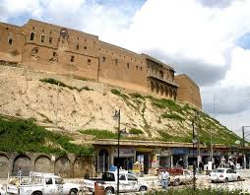

Slide 51
1- procedures are suggested for improving the physical structure:
- Improving the building conditions of the district in general
- Designing the buildings’ facades and the streets that suit the traditional
character of the district by means of building materials and street
furniture, roofing, lighting, etc.
- The emphasis on the Citadel as a major attraction of the district by
means of building heights.
- Highlighting the buildings of cultural heritage value by means of
lighting.
- Providing the needs and satisfaction of tourists:
- This is related to the processes of maintenance and renewal for the
elements of the urban environment to improve their efficiency.

Slide 52
2. Functional System:
procedures are suggested for improving the functional structure:
- The improving the existing functions to be used as tourist attractions or facilities, for example improving the commercial function to serve as a shopping attraction.
- Including new functions to serve as a tourist attractions such as the cultural functions, or leisure functions such as coffee shops.
- Including new facilities such as new tourist hotels, restaurants, and museums.
- Supplying the necessary needed facilities such as the cultural and
entertainment facilities.
1. Tourist-Cultural: for activities such as museums, libraries, theatres, museums, and multi-purpose halls.
2. Commercial: where the commercial character is kept with using it as a shopping attraction.

Slide 53
3. Residential: to sustain the character and vitality of the district even during
non tourist seasons, residential land use should be maintained.
4. Tourist lodging: to develop forms of tourist lodging in the districts such as
using traditional houses for this purpose or creating other forms, with
considering the character and skyline of the district.
5- addition night facilities in the area to make continuity for life in all times
3-. Tourist Services:
Erbil city center includes hotels distributed in Arab and Bazar quarters, and one hotel “Erbil Tower” in Mustawfi district.
The buildings of these hotels are unattractive, mostly worn and the service such as cleaning is low..
Other services that could relate to tourism such as restaurants and coffee shops are even in worse conditions. The existing catering services are limited to few restaurants that serve shop owners and local shoppers.
These services have bad or medium building conditions. Coffee shops of Erbil city center also do not have an appealing look either and their main function is to serve local citizens.

Slide 56
Thanks for listening

