Slide 1

Performance Measurement of Processes and Threads Controlling, Tracking and Monitoring Based on Shared-Memory Parallel Processing Approach
Asst. Prof. Dr. Eng. Subhi R. M. Zeebaree
(CCE Dept. – Eng. College - Nawroz University)
and
Asst. Lect. Karzan Hussein Sharif
(University of Human Development)
3rd. Scientific Symposium

Slide 2
Aims of Research
Design an algorithm for building a software application to make self- checking of PC system-information. Provide monitoring capability to all processes currently in the system with full details, Tracking the termination state for each of them or the entering of new processes into the system.
Providing full monitoring, controlling, tracking and re-monitoring of all possible cases of Single/Multi processes/threads with all information related to them including elapsed kernel time and context-switching, and pausing/running/killing of these processes/threads, forcing them to specified CPUs and changing their priorities.

Slide 3
Single and Multi Processor Systems
Single Processor Systems
Multi Processors Systems

Slide 4
Proposed Algorithm
Self-Checking Part
Under-Testing Programs Part

Slide 5
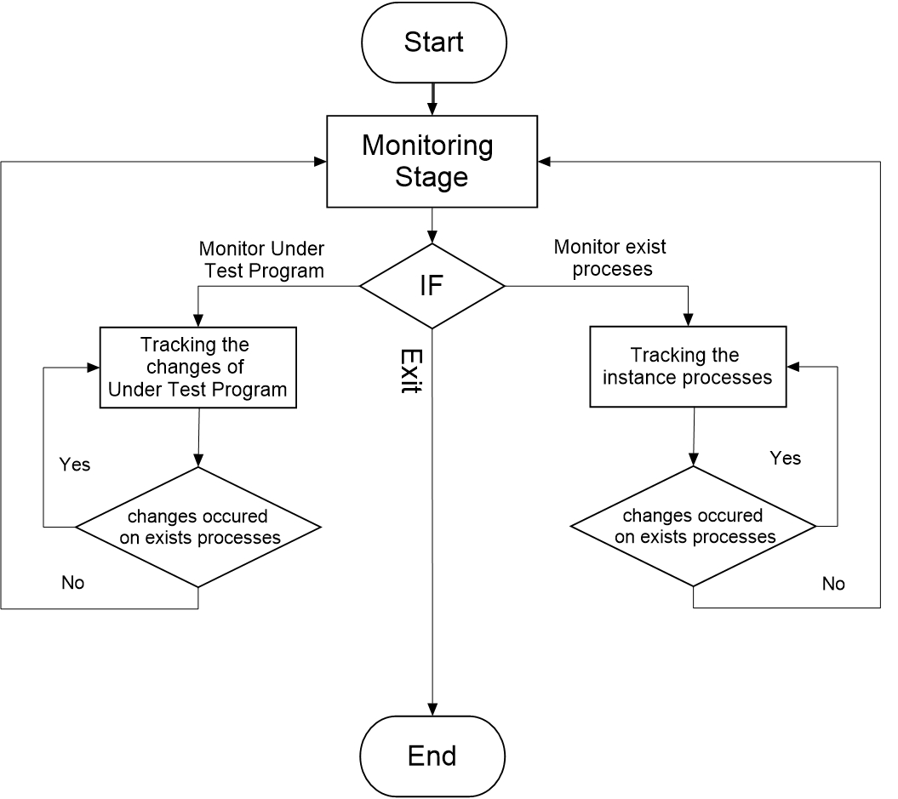
General Representation-Structure of This Work

Slide 6
Self-Checking Part
This part makes monitoring on all existing processes before/during running this SW-Application which are out of the testing-programs.
Summary of Calculated Features
User Time.
Kernel Time.
Elapsed CPU Time.
Elapsed Running Time.
CPU usage.
CPU Ending-Execution-Time.
Average Ending-Execution-Time for each process
Waiting Time for each thread.

Slide 7
Under-Testing Programs Part
Controlling-Information Section
Start/Kill
Stop/Resume
Change Priority
Change Target CPU

Slide 8
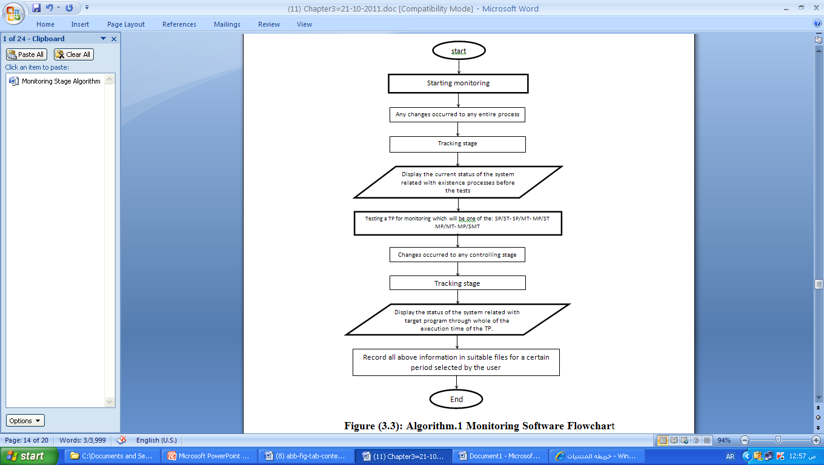
Monitoring Stage Algorithm

Slide 9
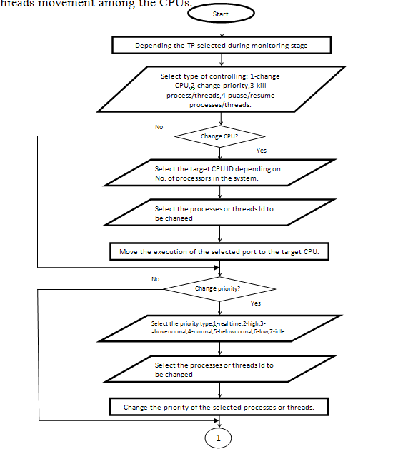
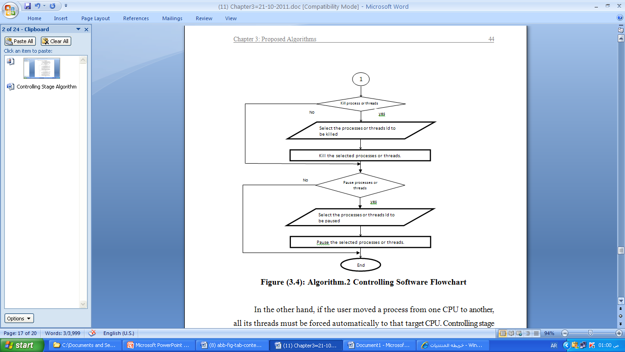
Controlling Stage Algorithm

Slide 10
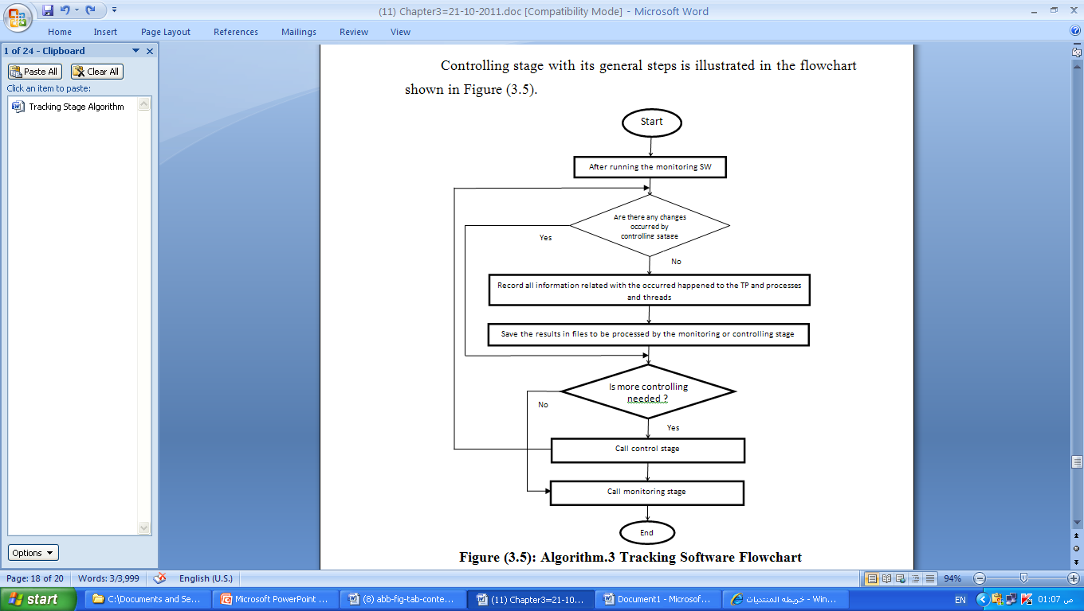
Tracking Stage Algorithm

Slide 11
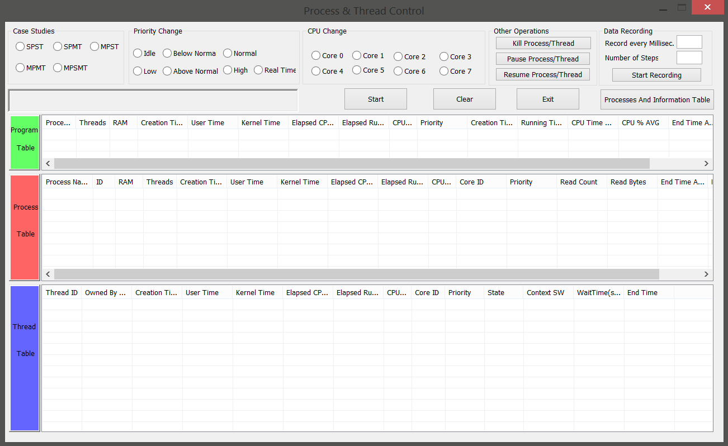
The GUI Representation of Application Software

Slide 13
The GUI Representation of Application Software

Slide 15
The GUI Representation of Application Software
Main Window with General System Information

Slide 16
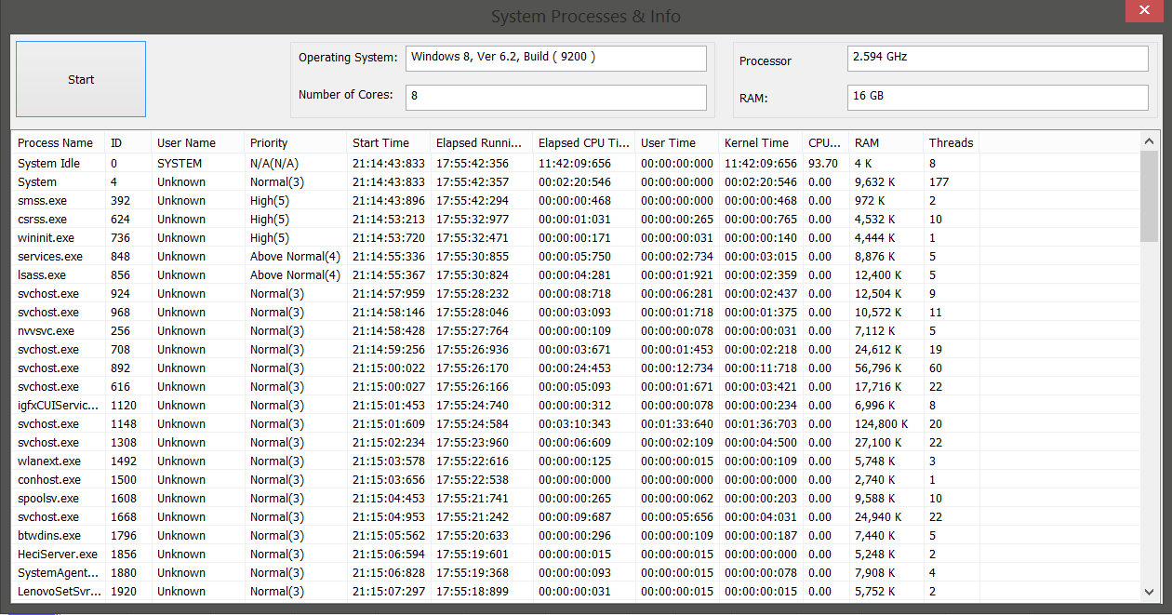
The GUI Representation of Application Software
Main Window after Browsing the Features of the Existed Processes

Slide 17
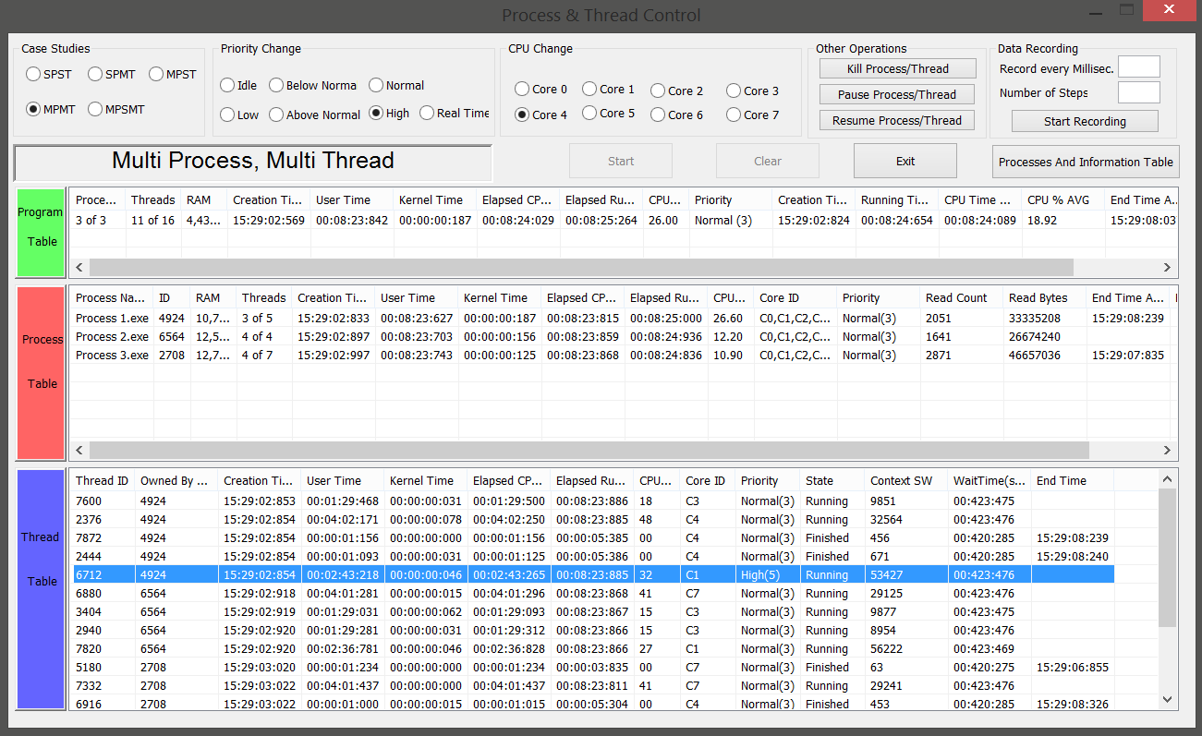
The GUI Representation of Application Software
Program, Process, Threads and Control Sections

Slide 18
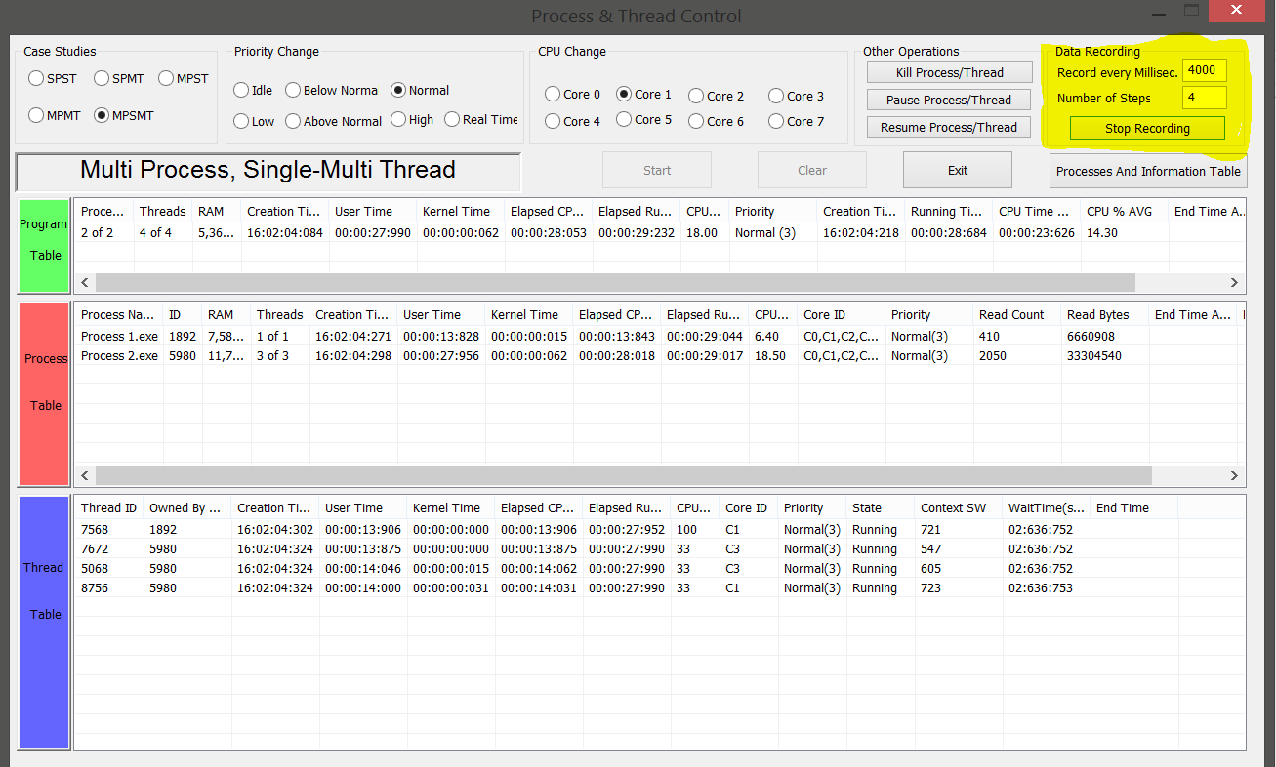
The GUI Representation of Application Software
Operation of Recording the Monitored Data

Slide 19
Case Studies (Controlling)
Example: MP/ST: Processes=4, All on CPU1
Context Switching for (Process 2)

Slide 20
Case Studies: MP/SMT: Elapsed Running Time for Threads of P2 of MP/SMT, All Threads Normal Priority using Core i7

Slide 21
Case Studies: MP/SMT: Elapsed Running Time for
Threads of P2 of MP/SMT, Thread3 High Priority using Core i7

Slide 22
Case Studies: Elapsed Running Time for Threads of P2 of MP/SMT, Thread2 Low Priority and Thread 3 Real Time Priority using Core i7

Slide 23
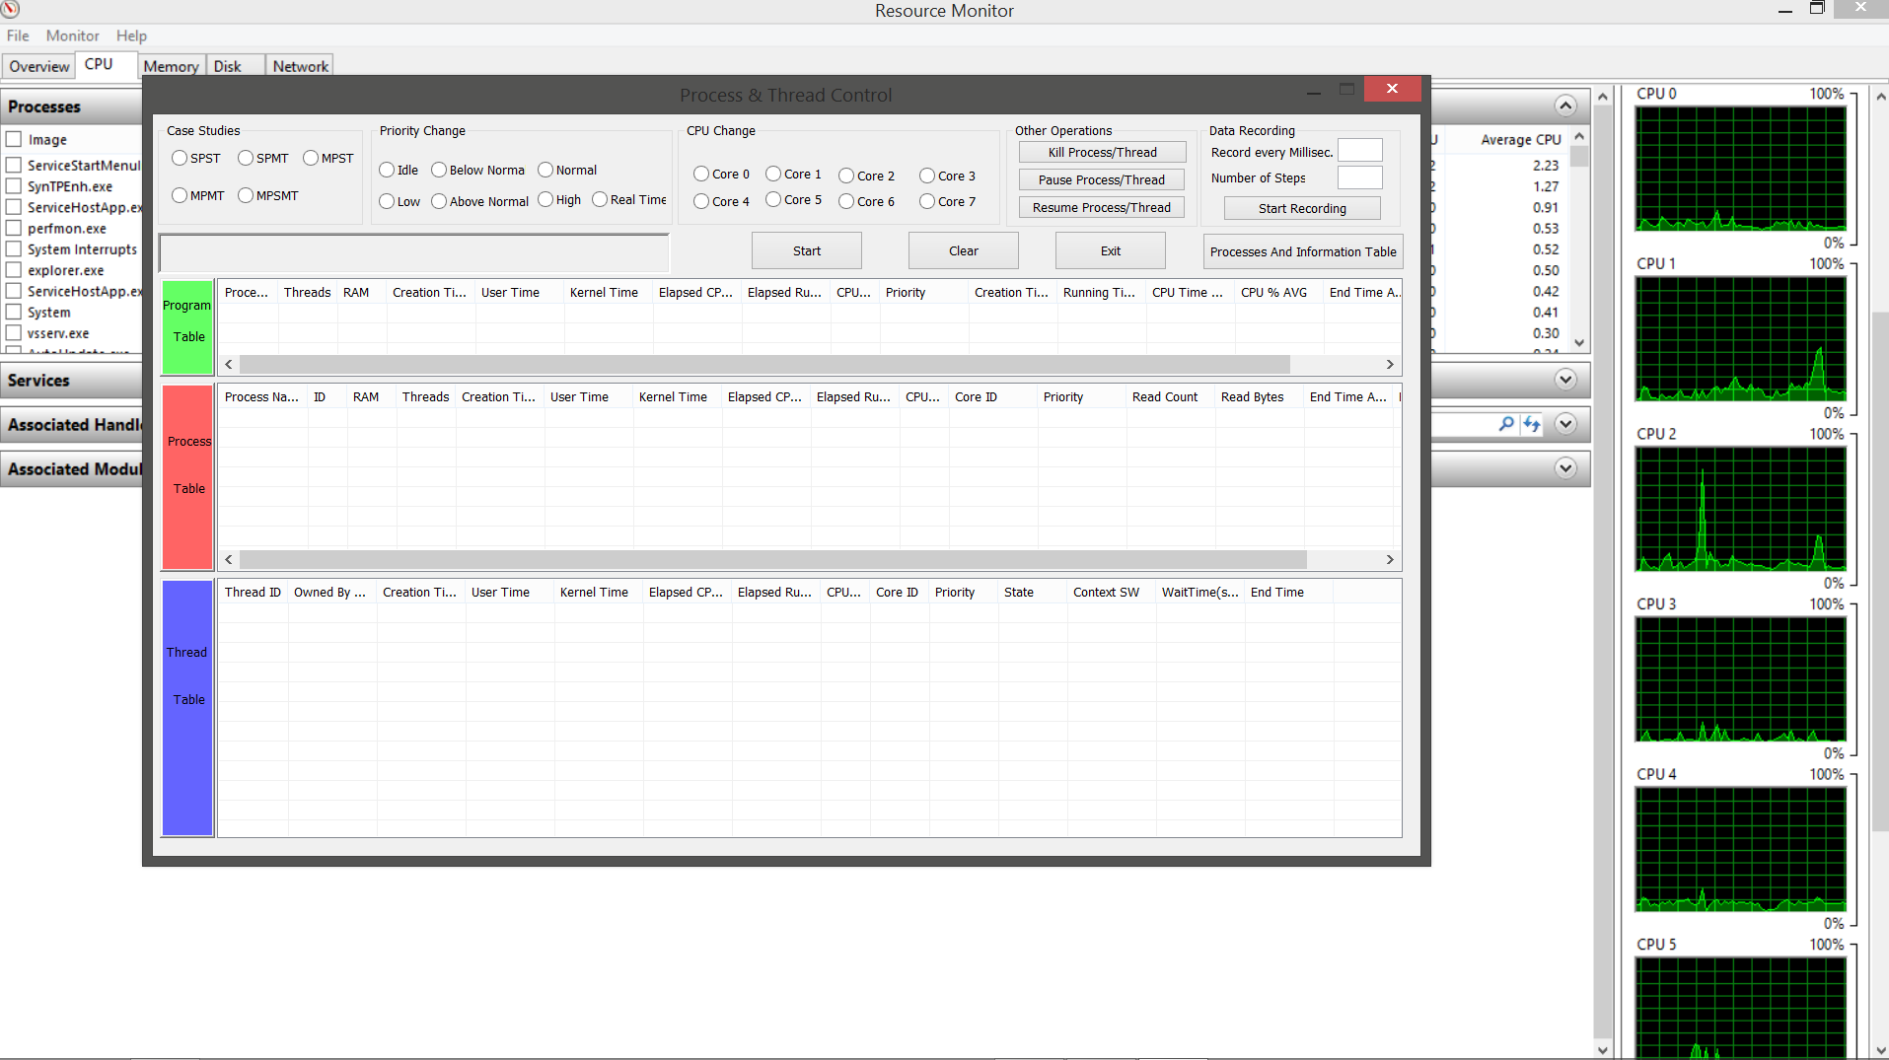
Case Studies: Status of the CPU-Usage History of the Task Manger before Forcing to CPUs

Slide 24
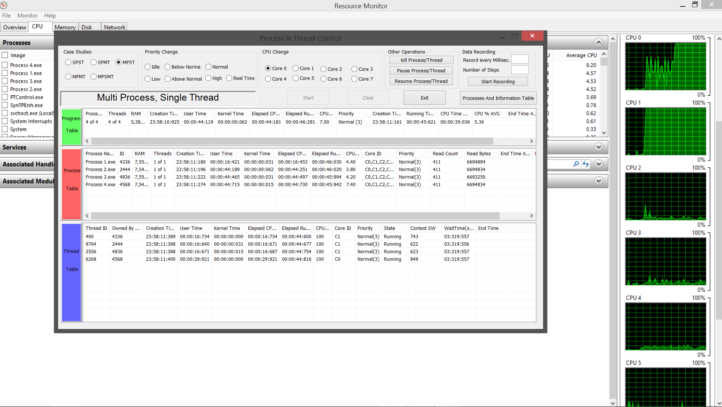
Case Studies: Effect of CPU-Changing by PMS on the Status of CPU-Usage of System’s Task Manger. (P1, P2 and P3 allocated to CPU1, and P4 to CPU0).

Slide 25
Conclusions
Monitoring the following items and features:
  Systems information.
  Existed processes in the system, with all its features.
  All possible cases of shared memory systems parallel processing approach (SP/ST, SP/MT, MP/ST, MP/MT, MP/SMT), with the following features:
    Monitoring the tested-program.
    Monitoring all processes of tested-program.
    Monitoring all threads of all processes of the tested-program.

Slide 26
Controlling the tested-program, processes and threads with the following characteristics:
  Pausing/Resuming/Killing.
  Forcing from certain CPU to any other one.
  Changing the priority.
Tracking the changes by recording all changes.

Slide 27
Adding to the above abilities, this work provides the following calculations:
Total execution time.
CPU execution time which include both of:
  Kernel time.
  User time.
Waiting time.
Context Switching.
CPU usage.
Priority.

Slide 28
Thanks

