Slide 1
Prof. Dr.
Jassim M. Abdul-Jabbar
&
Dr. Mohammed J. Mohammed
Unconstrained Iris
Reconstruction
using Countourlet Transform

Slide 2
Why Iris?
Iris is the best biometric tool for human identification because of its properties of
uniqueness, even for a twin.
lifetime stability, doesn’t varied with time.
Iris semi-circular shape, which leads to easy segmentation method reflecting high recognition rates.
Thus, iris recognition is one of the most stable and reliable means in biometric identification.

Slide 3
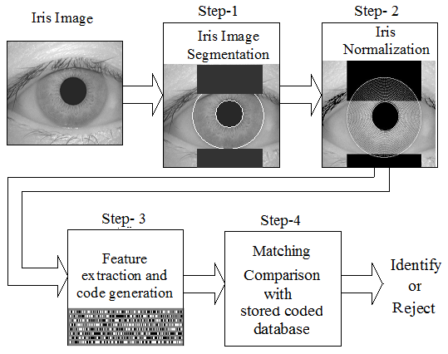
Iris Recognition Algorithm
      A classical iris recognition algorithm usually consists of four steps:
      -Segmentation,
      -Normalization,
      -Feature
      extraction
      with coding
      and
      -Matching.

Slide 4
Modification Objects
      * A one or more of these steps (such as segmentation or feature extraction) can be modified to obtain
      Small-length best-fit code vector
      High recognition rate
      Efficient system realization (less-complex computations)

Slide 5
New Circular Contourlet Filter Bank
* One of these modifications is to apply a non-traditional step for feature extraction where a new circular contourlet filter bank can be used to capture the iris characteristics.
* The idea is based on a new geometrical image transform called Circular Contourlet Transform (CCT).

Slide 6
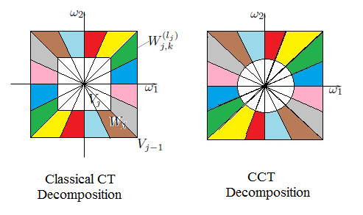
CCT Vr. Classical CT
A multi-level-multi-directional circular contourlet decomposition is applied.
Highly-discriminative frequency regions due to the use of circular-support decompositions result more extracted high frequencies will be included at each directional region. (more feature components)
Resulting in more-accurate reduced-fixed-length quantized feature vectors and reflecting high recognition rates for the proposed system.

Slide 7
Unconstrained Iris Reconstruction
Although, iris is the best biometric tool for human identification, but usually iris images suffer from unconstrained conditions,
Ideal image acquisition conditions are assumed in the classical iris recognition system. These conditions may include:
- Near infrared (NIR) light source, for clear iris texture and iris look retrieval.
- Stare constraints, with open eye.
- Close distance from the capturing device.
However, when these constraints are relaxed for real conditions, the recognition accuracy in most systems decreases.
Recently, different processing methods for iris images captured in unconstrained environments are adopted.

Slide 8
The Proposed System for Unconstrained Iris Reconstruction using
CCT Decomposition

Slide 9
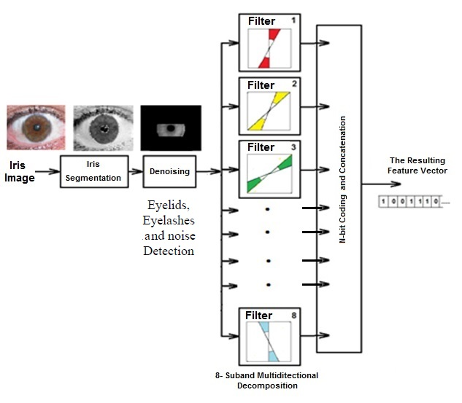

Slide 10
Feature Vector (Code Generation)
To create our iris feature vector, the following steps are carried out:
1) The resulting 8-sub bands are formed as (Matrix1, Matrix 2, ……., Matrix8).
2) Specific sub-features are calculated for each of the 8 matrices.

Slide 11
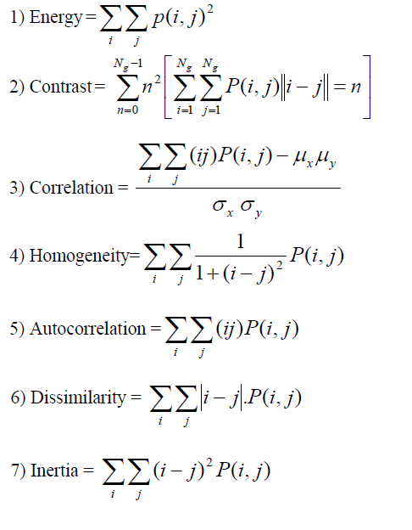
3) The final iris feature vector is formed by concatenating these specific features as follows:
V =[En1,Cont1,Cor1, Hom1, Acor1, Dis1, Ine1, En2, Cont2, Cor2, Hom2, Acor2, Dis2, Ine2, ……………, En8, Cont8, Cor8, Hom8, Acor8, Dis2, Ine2]
4) A final iris feature vector of 56 element can be obtained.

Slide 12
Data Sets
- Since 2002, CASIA datasets existed
- In 2005, the UBIRIS datasets presented
In 2010, the UBIRIS.V2 dataset and CASIA-IrisV4 were released, containing data captured
in the visual wavelength,
at-a-rang (between 4-8 meters) and
on on-the-step. These dataset are ready for anyone interested in studying iris recognition and useful in accessing the feasibility and in specifying the related recognition constraints.

Slide 13
Results and Conclusions
In some initial results, the accuracy of the proposed method becomes more than 94%.
Since the discrimination between high and low frequencies is based on filters with circular-support cutoff curvatures then robust coefficients can be achieved in high frequency bands compared to those achieved when using the classical wavelets or even the classical contourlets.
All used filters can easily be realized by masks which reflects again a reduced-complex realization of the whole recognition system.

Slide 14
Thank you

