Slide 1

Nawroz University
College of Engineering
Dept. of Computer and Communication
Secure Diffie-Hellman Algorithm
By:
Assist. Lect. Alnawar J. Mohammed
Assist. Lect. Zahraa D. Abdulhadi

Slide 2
Introduction
Nowadays, data security and privacy are a prevalent issue.
Researchers are trying to do their best to find out the perfect way to secure the data efficiently.
One of these solutions is encrypting the data using cryptography algorithms.
Cryptography: is the science of converting the readable information into unreadable or hidden, and only the authorized persons or machines can retrieve or obtain the original texts.

Slide 3
Types of Cryptography
It is divided into two major types (symmetric and asymmetric) regarding their keys.
CRYPTOGRAPHY
No. of Keys Used
Symmetric cryptosystems
Asymmetric cryptosystems
Notes:
Symmetric cryptosystems require the users to have the same key to be used for encryption and decryption process
Asymmetric cryptosystems require the users to have two different keys (encryption key and decryption key).

Slide 4
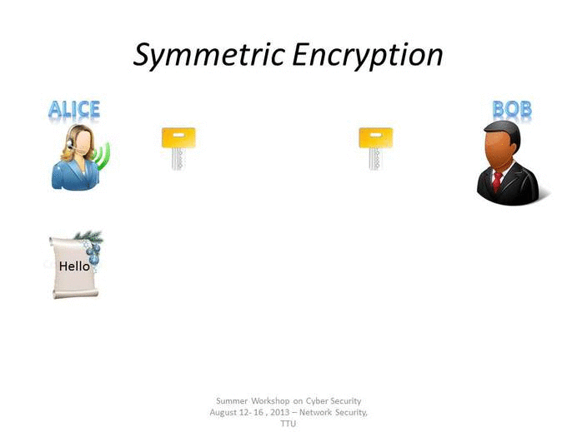
Symmetric-Key Cryptography

Slide 5
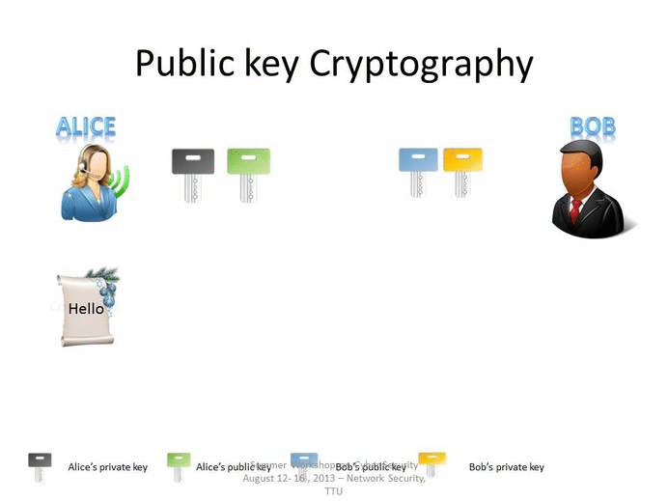
ASymmetric-Key Cryptography

Slide 6
The Need for a Key Distribution Protocol
Symmetric key should be changed from time to time to make it more secure and unbreakable to prevent other users from obtaining the plain text.
Therefore, the security of any symmetric cryptography system depends on key exchange protocol used by the system.
Key exchange protocol is the way of distributing the keys in a secure manner among the users.
Diffie-Hellman protocol is one of the key exchange protocols.

Slide 7
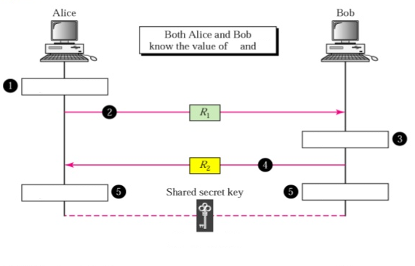





Traditional Diffie-Hellman Method
p
g
$R_{1}=g^{x}$mod p
$R_{2}=g^{y}$mod p
$K={{(R}_{2})}^{x}$mod p
$K={{(R}_{1})}^{y}$mod p
$K=({g)}^{xy}$mod p
Where, The first number, p, is a prime number.
The second number, g, is a random number.
Notes:
Diffie-Hellman key exchange protocol was brought in 1976 by Whitfield Diffie and Martin Hellman [2], this protocol is widely used for secure key exchange. The process of this protocol supposes that Alice and Bob have different private keys and they have to agree upon two relatively prime numbers p, g then each of them uses the obtained information to calculate the public keys. After that they share their public keys between each other and use it with the private one, p and g to get the same shared key. As a result, both of Alice and Bob obtained the shared key without sending their private keys through the channel [3].

Slide 8
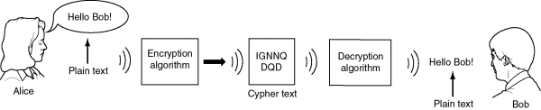
Example
Two Internet users, Alice and Bob wish to have a secure conversation.
  - They decide to use the Diffie-Hellman protocol

Slide 9
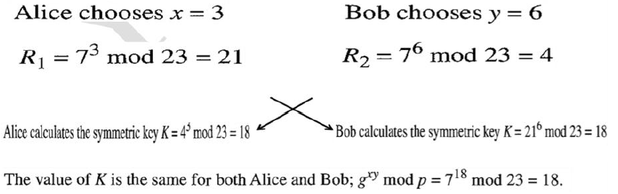
Example
Alice and Bob get public numbers
  P = 23, g = 7

Slide 10
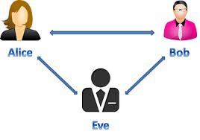
Diffie-Hellman Key Exchange -Weakness
In this paper, we will explain the problem of Man-In-The-Middle (MITM) attack in Diffie-Hellman protocol.
The MITM attack is a form of eavesdropping where the communication between two users is monitored and modified by an unauthorized party.
Notes:
The attacker actively eavesdrops by intercepting the public-key message exchange and retransmit the message while replacing the requested key with his own

Slide 11
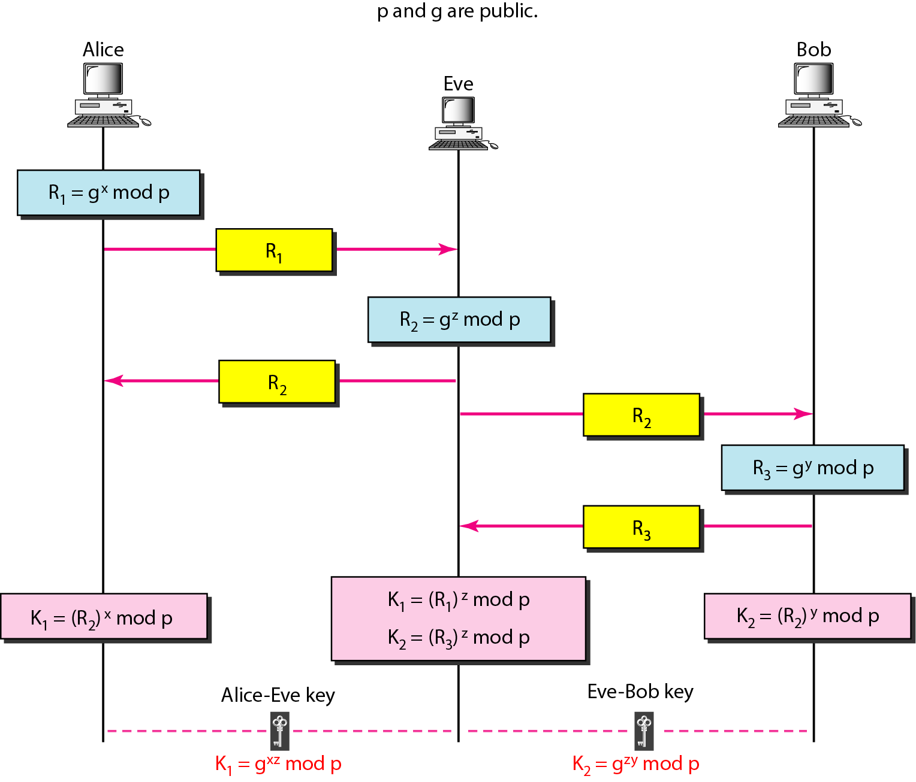
Man-In-The-Middle (MITM) attack
Notes:
As a result, Eve can attack the communication channels and record the messages that would be sent from Alice to Bob, and later Eve sends a copy of the messages to Bob. This will make Bob feels that those messages coming from Alice. Eve might send the message back to Alice, who would trust that it came from Bob

Slide 12
PROPOSED WORK
This paper proposes improvements which can help preventing MITM attack. These can verify and secure the communications between Alice and Bob.
The first step in this improvement is to choose a secret value (C) Known by only Alice and Bob.
The value of (C) will be imported from the Key Distribution Center (KDC).
The value of (C) will be added on both sides (Alice and Bob) to make the improvements on the calculations of the final secret key.

Slide 13
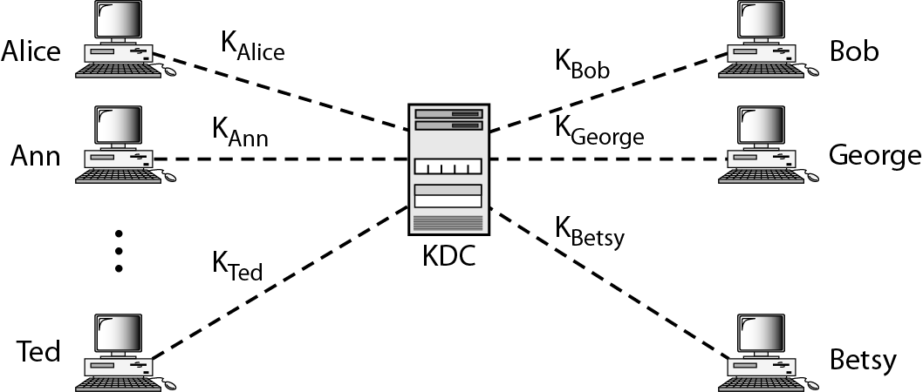
At first, each person, like Alice and Bob, establishes a shared secret key with the KDC.

Slide 14
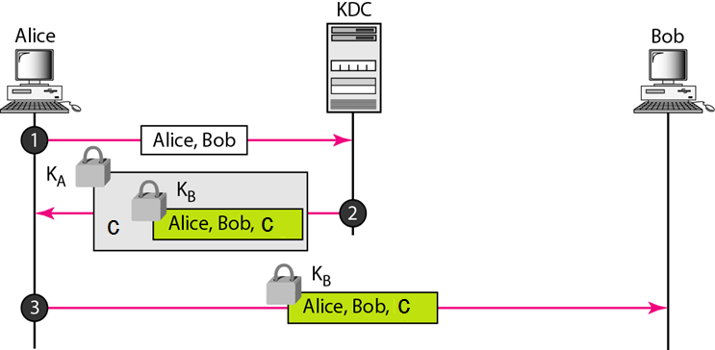
Import the value of (C) from KDC

Slide 15
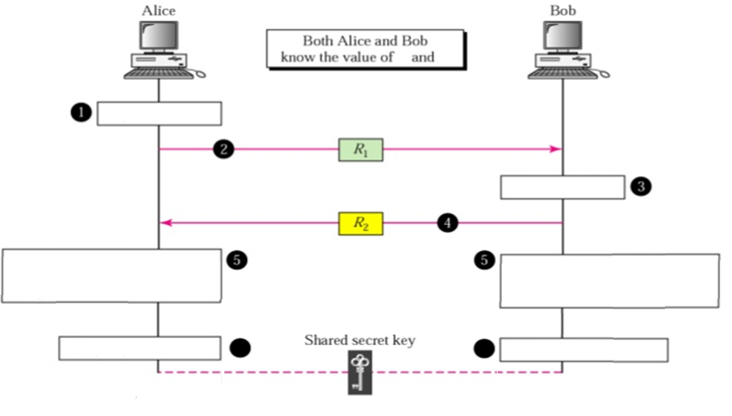






The Modified Diffie-Hellman Method
p
g
C : is the New secret value Known by only Alice and Bob
$R_{1}=g^{x∗c}$mod p
$R_{2}=g^{y∗c}$mod p
$g^{xy}=\sqrt[c^{2}]{{{(R}_{2})}^{x∗c}}$ =$\sqrt[{\begin{aligned} \\ c\end{aligned}}^{2}]{g^{xyc^{2}}}$
$g^{xy}=\sqrt[c^{2}]{{{(R}_{1})}^{y∗c}}$ =$\sqrt[{\begin{aligned} \\ c\end{aligned}}^{2}]{g^{xyc^{2}}}$
6
6
$k_{ab}=g^{xy}$mod p
6
6
$k_{ab}=g^{xy}$mod p

Slide 16
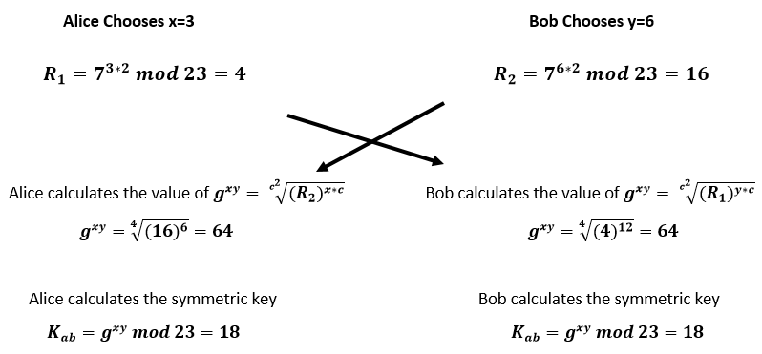
Example
Alice and Bob get public numbers
  P = 23 , g = 7
  They also get the secret value of C from the KDC
  C = 2

Slide 17
